Slide 1
RIDETRUE · PROTOCOL FLOW
Claim Cycle
End-to-end automated · oracle-verified · settled on-chain
01
STAGES
06
02
01
INCIDENT
Accident, theft, or damage event
RideTrue
claim cycle
02
CLAIM SUBMISSION
Submitted via app to smart contract
03
ORACLE VERIFICATION
Multi-source evidence aggregated
05
03
04
CONSENSUS
Validators reach quorum on validity
05
AUTOMATED PAYOUT
USDC released from pool to rider
04
06
POOL REBALANCE
Reserves and premiums recalibrate
Smart-contract enforced · stablecoin settled · transparent by design
MotoChain & RideTrue

Slide 2
RIDETRUE · MONEY FLOWS
Where the Money Goes
What comes in · What goes out · Year 1 (realistic model from Section 5.9)
MONEY IN
MONEY OUT
RIDER PREMIUMS
2,000 riders × ₩90K/mo → ₩2.16B
RIDETRUE
INSURANCE POOL
Year 1 total flow
₩5.25B
processed
CLAIMS PAID TO RIDERS
Verified claims, paid in USDC → ₩750M
LP POOL CAPITAL
Foundation + DeFi + institutional → ₩3.00B
SAFE-RIDER REBATES
Returned to claim-free riders → ₩216M
B2B DATA FEES
Insurers, lenders, marketplaces → ₩60M
RESERVES & REINSURANCE
Catastrophe + liquidity buffer → ₩1.19B
DEFI YIELD
Conservative returns on reserves → ₩30M
TEAM & OPERATIONS
Engineering, audits, BD, security → ₩1.80B
EXAMPLE · ONE RIDER · ONE YEAR
PAID IN
RECEIVED BACK
NET PREMIUM
Ji-min · 28 · delivery rider · Seoul
₩1,080,000
₩180,000
₩900,000
Safety score 92/100 · top quartile · zero claims Y1
₩90,000 × 12 months
Safe-rider rebate (top quartile)
for full-year coverage
vs. comparable Korean motorcycle policy ₩1.0M–₩1.4M → fairer pricing, portable behavior score, and claims paid on-chain in days.
Stress-tested model · 15% claim frequency · ₩2.5M average severity
MotoChain & RideTrue

Slide 3



RIDETRUE · MECHANIC TRUST
How We Stop Fraud
Three layers of defense — built into every service record on MotoChain
PREVENTION Stop fraud before it can happen
01
BOTH SIGN OFF
02
BUILT-IN SENSORS
The mechanic AND the bike owner have to confirm every service entry. No one can fake a repair the owner didn't agree to.
Hardware reads mileage and key events directly from the bike. No room to fudge the odometer.
DETECTION Catch fraud when it tries to happen
03
BOUNTY HUNTERS WELCOME
04
RE-CHECK AT PAYDAY
Spot a fake record and prove it — earn a share of the cheater's stake. The community becomes the watchdog.
When the bike is sold, financed, or insured, we re-verify the history. Fraud is caught the moment it would pay off.
ENFORCEMENT Make fraud expensive
05
EARN TRUST, EARN MORE
06
WAIT BEFORE YOU GET PAID
07
RISK SCALES WITH ACTIVITY
Start small. As reputation grows, both your rewards and your stake at risk grow with you.
Fees sit in escrow for 30–90 days. Any dispute claws the fee back and slashes part of the stake.
Each entry locks a slice of stake. Log a lot, have a lot to lose. Throwaway accounts can't profit.
Each layer covers what the others miss — none of them works alone, all three together make fraud unprofitable
MotoChain & RideTrue

Slide 4
RIDETRUE · STRESS TESTING & BLACK SWAN PLAN
Built to Survive
Nine safeguards across three layers — what keeps the pool standing when many claims hit at once
1. RESERVE LAYERS capital buffers built before anything goes wrong
01
LIQUID RESERVE
02
CATASTROPHE RESERVE
03
REINSURANCE BACKSTOP
≥25% of pool always liquid. Never deployed to DeFi yield.
20% of every premium routed aside. Used only in extreme events.
External partner covers tail risk above pool capacity. Required before launch.
25%
20%
Tail risk
2. AUTOMATIC SAFEGUARDS always-on rules baked into the smart contracts
04
CIRCUIT BREAKER
05
COVERAGE CAPS
06
CONSERVATIVE YIELD
Auto-triggers emergency mode on claim spikes, low reserves, disaster zones, or 3× volume.
Max ₩5M for normal claims, ₩3M for catastrophes. Clear exclusions on force majeure.
Max 10–15% of pool deployed to DeFi. Blue-chip protocols only. Always withdrawable.
4 triggers
₩5M / ₩3M
10–15%
3. CRISIS PLAYBOOK what happens when a black swan actually hits
07
STAGED PAYOUTS
08
PRO-RATA SHARING
09
PREMIUM ADJUSTMENT
Emergency mode: 50% paid immediately, 50% over 3–6 months as liquidity returns.
If pool is short, everyone receives a proportional share. Fair and transparent.
Post-shock: 10–20% temporary increase to rebuild reserves. Capped to protect riders.
50% / 50%
Fair share
+10–20%
Korean typhoons are base-case events, not tail events — calibrated accordingly
MotoChain & RideTrue

Slide 5

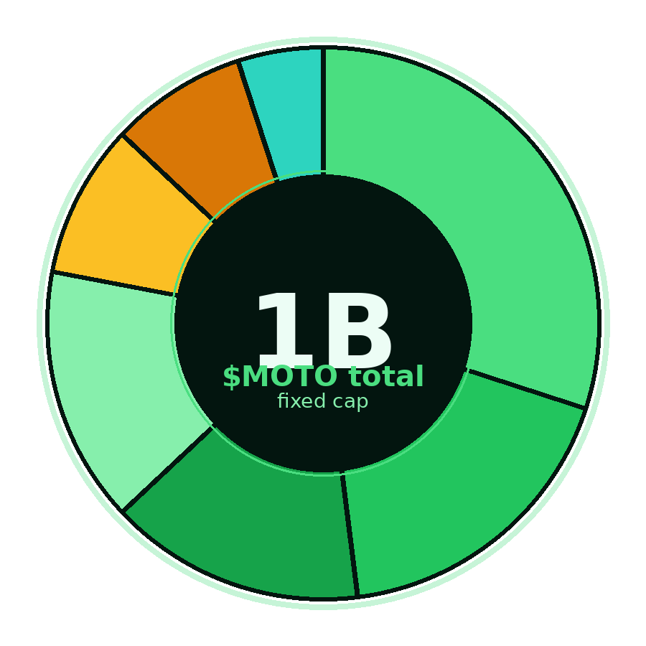
RIDETRUE · TOKEN DESIGN
$MOTO Token
Working draft — utility & governance only · no speculative payouts
TOTAL SUPPLY
NETWORK
STANDARD
INFLATION
1,000,000,000
Base
ERC-20
0%
fixed cap · no inflation
Ethereum Layer 2
governance + staking modules
fully diluted at TGE
01 · ALLOCATION
02 · TOKEN UTILITY
STAKING & SLASHING
Lock $MOTO to gain write or verification rights. Bad behavior gets your stake slashed.
GOVERNANCE
Token holders vote on fees, reserve ratios, rebate formulas, and supported integrations.
REPUTATION GATING
Tiered staking unlocks higher write limits and bigger reward shares for trusted participants.
Community & Ecosystem
30%
Team & Founders
18%
FEE DISCOUNTS
Treasury / DAO
15%
Pool Subsidy
15%
Pay select API and registration fees in $MOTO at a discount — collected fees are burned or sent to treasury.
Investors — Private
9%
Investors — Seed
8%
Liquidity Provision
5%
!
$MOTO IS UTILITY-ONLY
Insurance returns, rider rebates, and protocol revenue are paid in stablecoins — never in $MOTO. This separation protects users from speculative pressure and is deliberate.
Draft assumptions · final parameters subject to legal and token-design advisor review
MotoChain & RideTrue

Slide 6







RIDETRUE · COMPETITIVE LANDSCAPE
Who We're Up Against
Three competitor types — what they're good at, and where they break
CENTRALIZED HISTORY
TRADITIONAL INSURERS
DEFI INSURANCE
CARFAX · Korea Auto Inspection · AutoCheck
Samsung F&M · Hyundai M&F · DB Insurance
Nexus Mutual · InsurAce · Cover Protocol
WHERE THEY BREAK
WHERE THEY BREAK
WHERE THEY BREAK
Data is owned by them, not you. You can't take your history if you switch. There's no real penalty for fake records.
Behavior data is locked to one insurer. Pricing still relies on age and demographics. Innovation is slow.
Built for crypto-native risks like smart-contract bugs. No real-world data moat. Almost zero consumer reach.
OUR EDGE
OUR EDGE
OUR EDGE
Records are user-owned, signed, and economically staked. Fraud is automatically slashed — accuracy has skin in the game.
Behavior score follows the rider across providers. Pricing reflects actual riding. Claims settle on-chain in days.
Real-world motorcycle data. Identity + behavior in one stack. Consumer-grade UX via account abstraction.
OUR MOAT
Vertical data network effect
Every new bike, rider, mechanic, dealer, and partner makes the dataset more valuable — and harder for anyone to copy from scratch.
Two-wheelers only
Identity + Behavior
Korea-first wedge
Specialized data, not generic insurance
Two protocols, one stack — each reinforces the other
Dense urban motorcycle market, expandable across Asia
We don't beat any one competitor head-on — we own the intersection none of them can occupy alone
MotoChain & RideTrue

